Slide 1
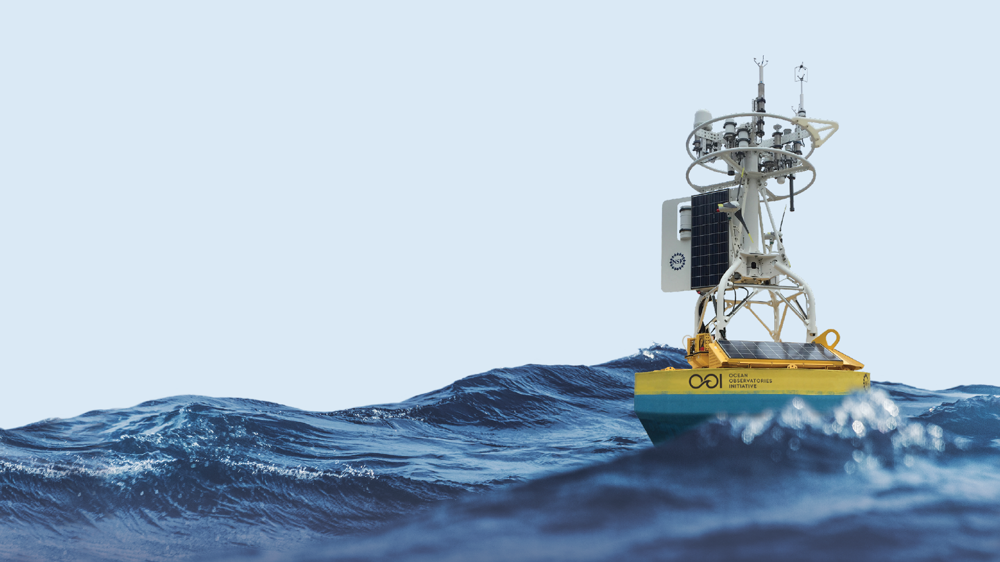



OOI Carbon System Data: Irminger Array
March 4th, 2022 Andrew Reed

Slide 2
Outline
Motivation
Overview of OOI & Global Irminger Array
Carbon System Instrumentation
Pro-Oceanus CO2-Pro ATM (PCO2A)
Sunburst SAMI-pH (PCO2W)
Sunburst SAMI-pCO2 (PHSEN)
Discrete Bottle Data
Methods
Results
Conclusions
Extra Resources for OOI Data
Notes:
Might just drop this slide

Slide 3
Motivation
OOI deploys instruments which measure the pH and pCO2 at our arrays in the open ocean and coastal locations
These instruments have now been deployed 7 or 8 times on year-long deployments to collect data
Additionally, we collect water samples during deployment and recovery of the instruments, and have them analyzed for a full-suite of parameters.
We want to demonstrate how you, the science user, can take advantage of the unique suite of data being provided by OOI and have the tools and methods to be confident in our data, dig deeper into the data, and use it do interesting and new science.

Slide 4
Vocab
Array
A collection of moorings and vehicles in a particular location (e.g. Global Irminger Array = Irminger Sea)
Deployment
A span of time a mooring or instrument were deployed and then recovered
Reference Designator (refdes)
An ID which indicates a particular location on an array for a particular type of instrument
Ex: GI03FLMA-RIS01-04-PHSENF000 = Global Irminger Flanking Mooring A - Instrument Riser - PHSEN (located at 30 m depth)
A reference designator will have multiple deployments of different PHSENs at the same location to make a timeseries
Stream/Datastream
A particular source or method of delivering data from a reference designator (instrument) to OOI
Ex: recovered_inst means data retrieved by downloading from the instrument following recovery
Instruments:
PHSEN (pH sensor): Sunburst SAMI-pH sensor
PCO2W (pCO2 water sensor): Sunburst SAMI-CO2 sensor
PCO2A (pCO2 water-atmosphere sensor): Pro-Oceanus
Notes:
https://oceanobservatories.org/knowledgebase/how-to-decipher-a-reference-designator/

Slide 5
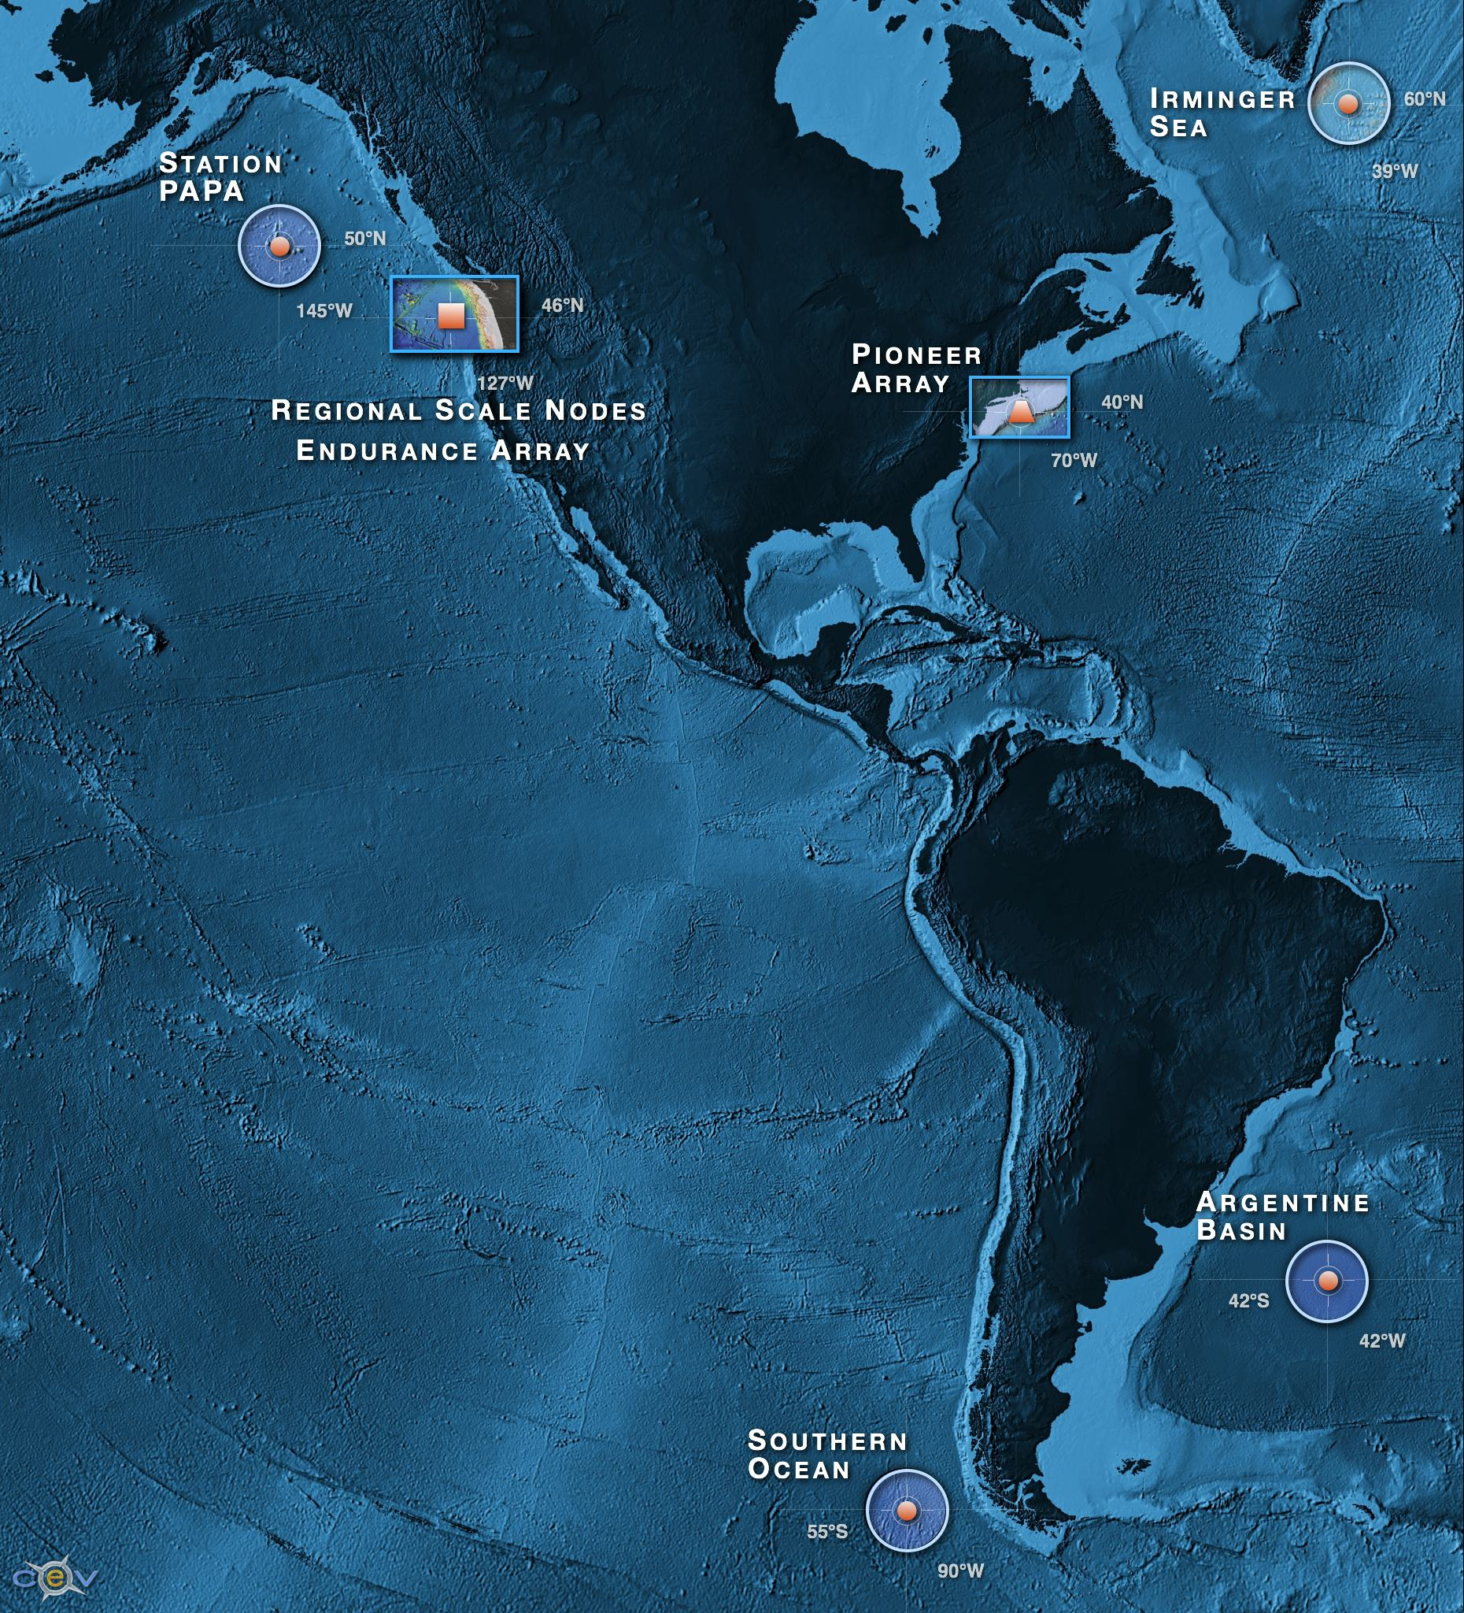
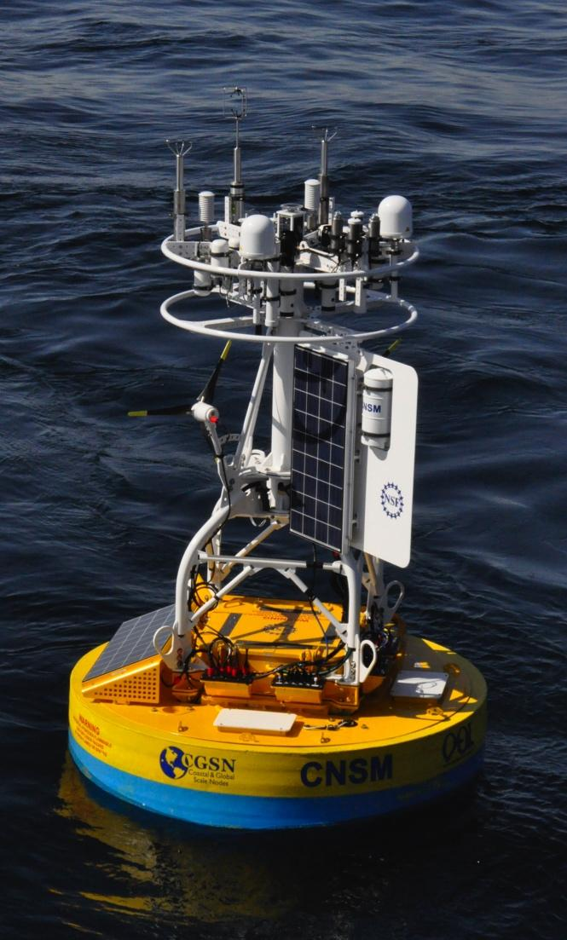
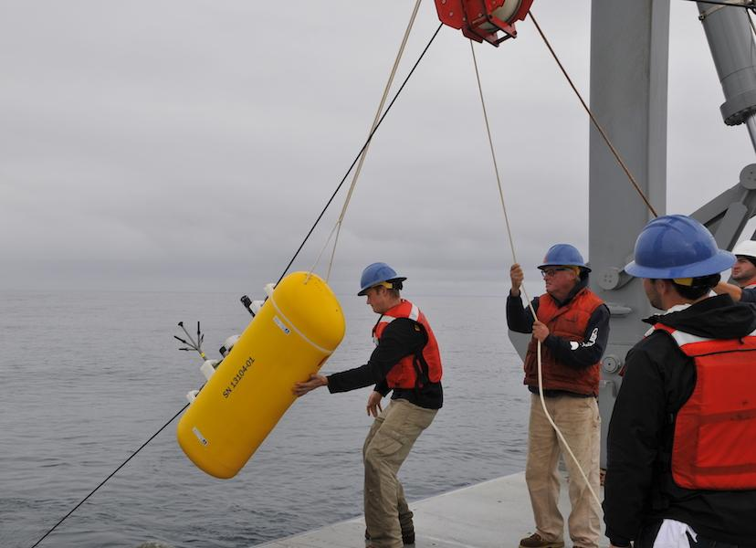
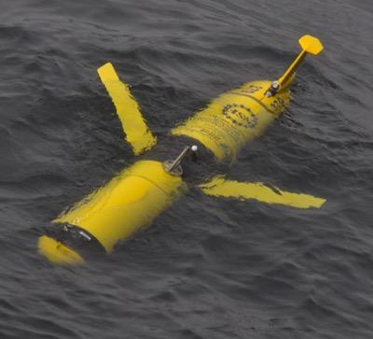

Ocean Observatories Initiative
NSF-funded project for long-term (25 years) infrastructure for ocean observations
Three main elements:
Regional Cabled Array (RCA) array
Endurance Array (EA) on the Oregon-Washington shelf
Coastal & Global Scale Nodes (CGSN) with moorings in the Irminger Sea, at Station Papa, in the Southern Ocean & Argentine Basin (descoped), and the Pioneer Array on the New England Shelf
CGSN infrastructure includes:
Surface moorings equipped with instruments on the buoy, at 7 m-12 m depth, along the mooring riser, and on the node on the seafloor (coastal-only)
Profiling moorings, with one or more wire following profilers and ADCPs
Gliders (3 & 12 month deployments)
AUVs
Subhead only
Notes:
OOI is a large NSF funded program with multiple elements. I'm just going to focus on one - Irminger Sea"

Slide 6
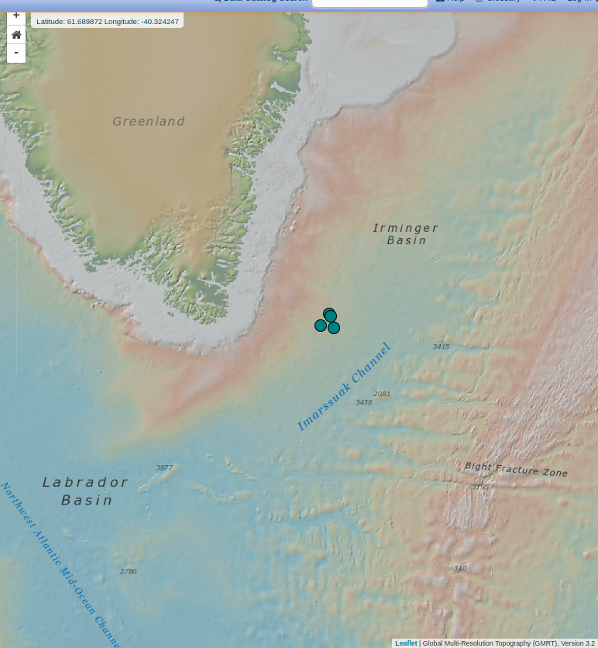
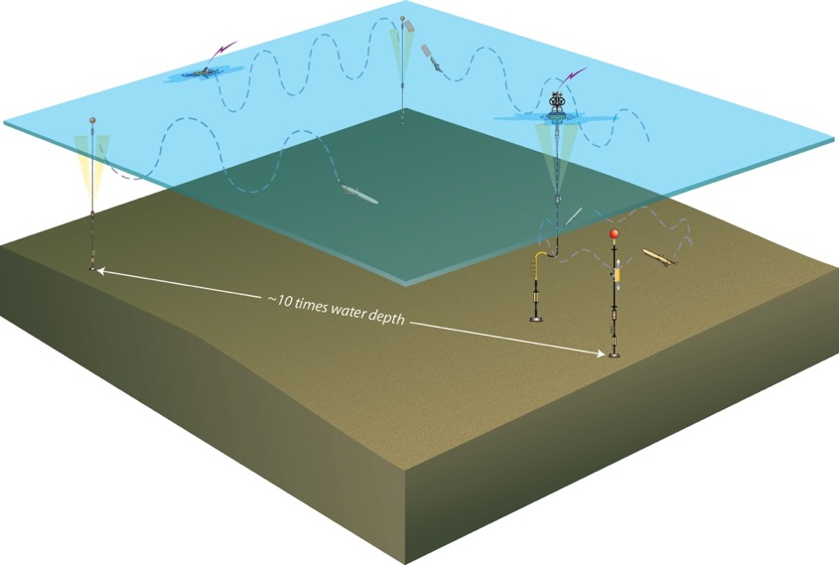
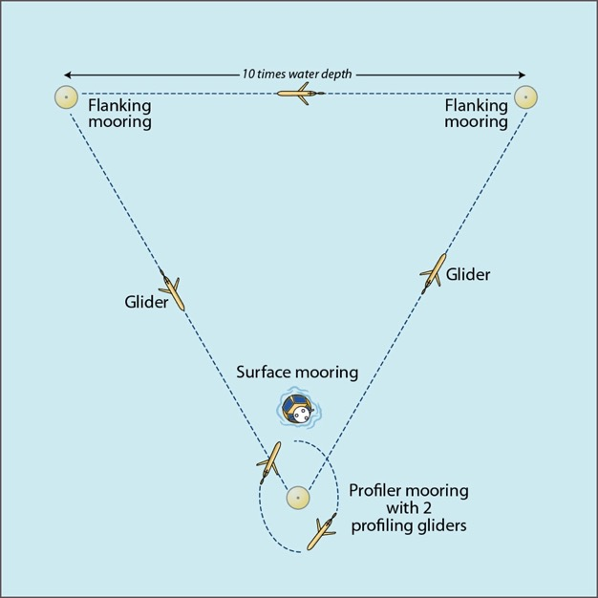
Irminger Array: (~60°N, 39°W)
Notes:
Get the importance of the Irminger Sea from a science perspective

Slide 7
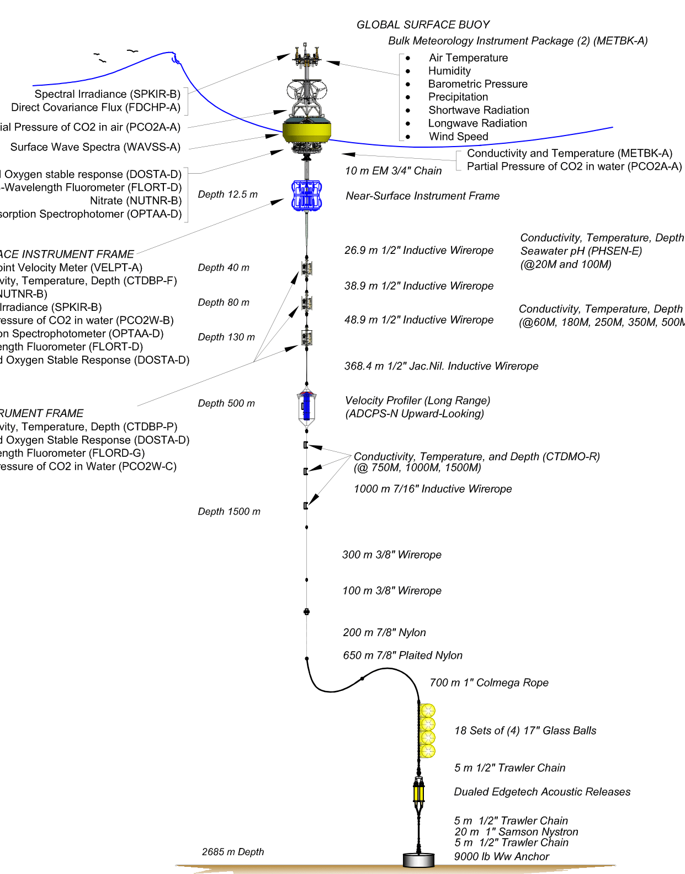
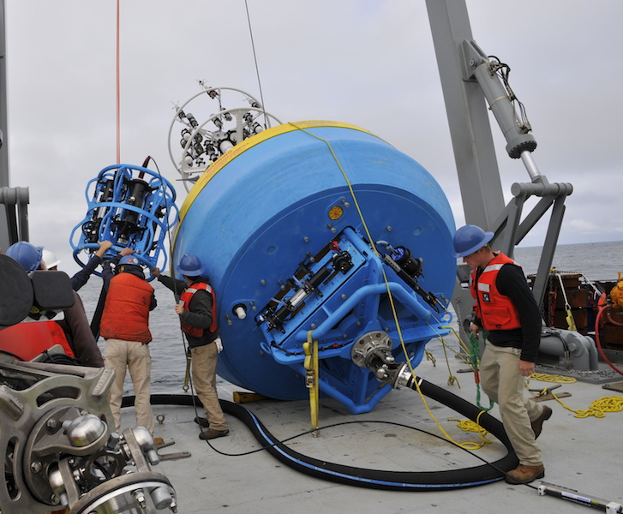
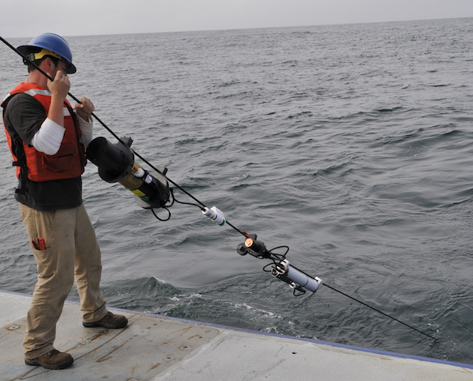
Global Surface Mooring
Surface-Atmosphere pCO2 sensor
(Pro-Oceanus CO2-Pro)
Seawater pCO2 sensor
(Sunburst SAMI-pCO2)
Seawater pH sensor
(Sunburst SAMI-pH)

Slide 8
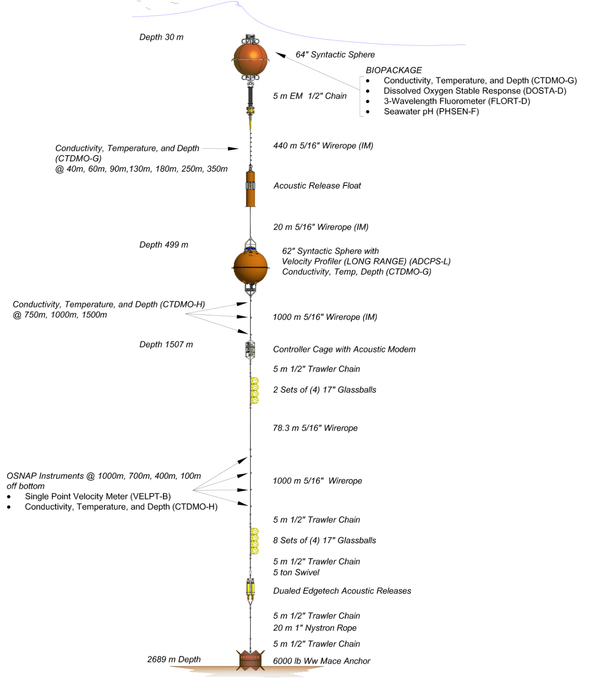
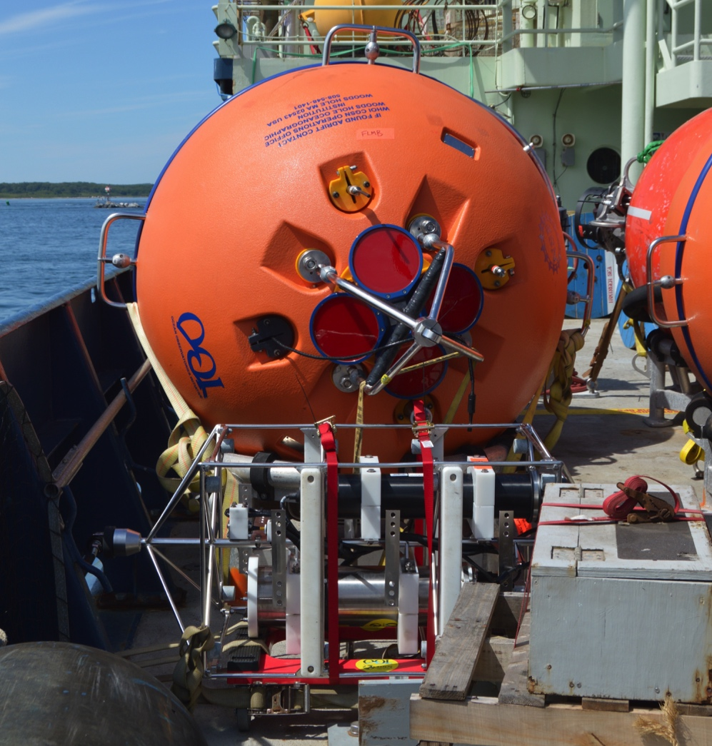
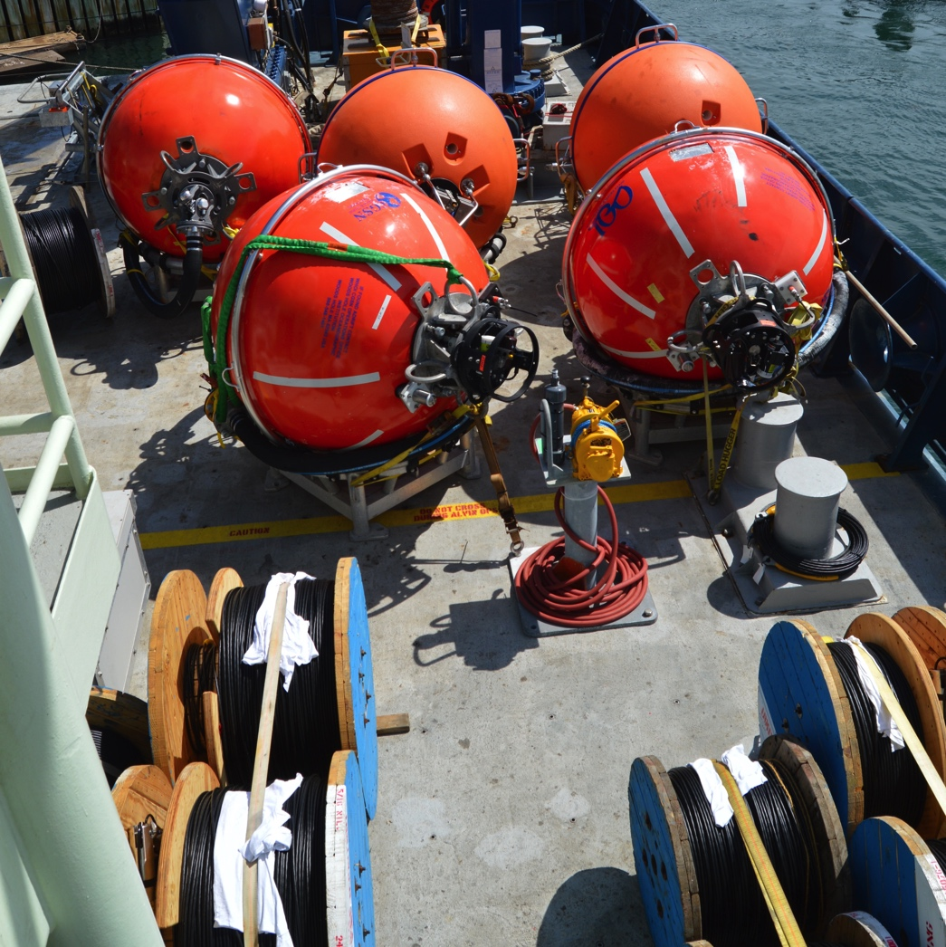
Global Flanking Moorings
Seawater pCO2 sensor
(Sunburst SAMI-pCO2)

Slide 9
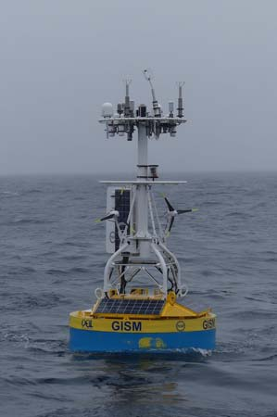
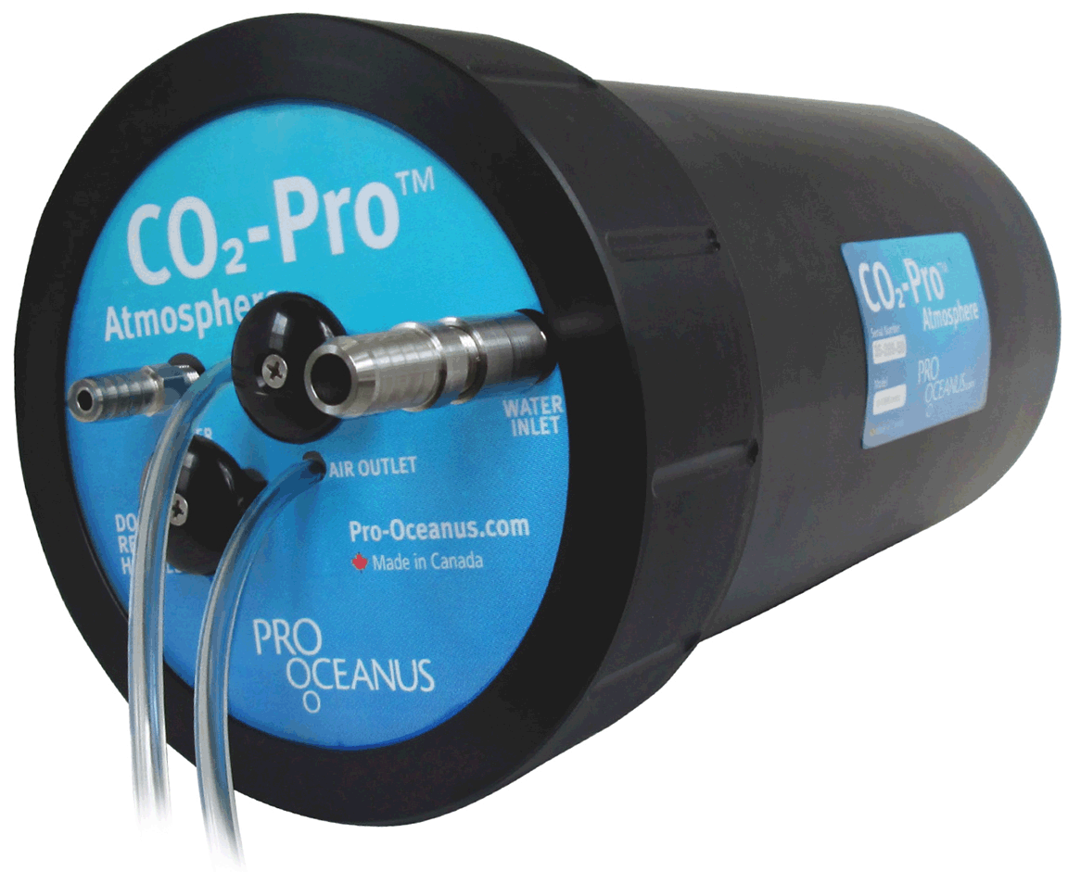
Instrumentation: Pro-Oceanus CO2-Pro ATM
Mounted on surface buoys at all arrays
Measures both surface water and atmospheric pCO2
Infrared absorbance method
Equilibrates across a CO2-permeable membrane
Measure CO2-via Non-Dispersive IR
Takes periodic zero-CO2 baseline measurements

Slide 10
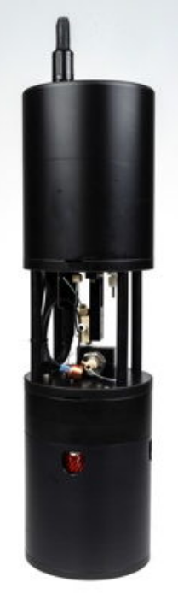
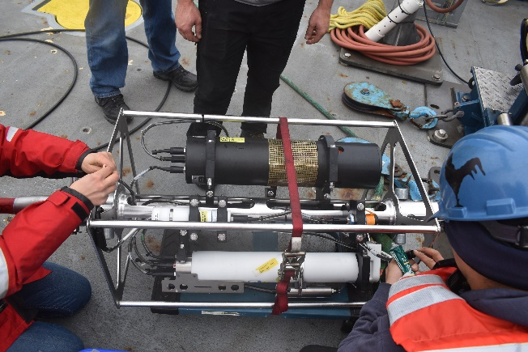
Instrumentation: Sunburst SAMI-pCO2
Measures the in-situ pCO2 with colorimetric reagent method
Takes a sample of seawater
Equilibrates a pH-sensitive dye with the seawater sample separated by a CO2-selective membrane
Titrates the dye with a standard reagent
Measures dye & blanks at 434 & 578 nm wavelengths
Manufacturer’s specifications
Accuracy +/- 3 uatm
Precision < 1 uatm
Drift < 1 uatm per year
Calibrated 200 - 1200 uatm
Mounted on:
Global Surface Moorings:
Near Surface Instrument Frame @ 12 m
Clamped on wire @ 40 m, 80 m, & 130 m

Slide 11
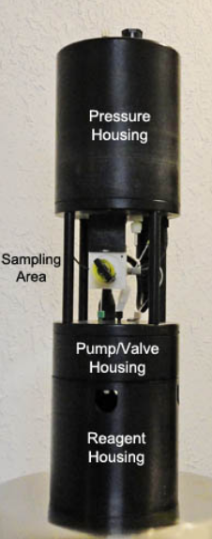
Instrumentation: Sunburst SAMI-pH
Measures the in-situ pH [Total scale] with colorimetric reagent method
Takes a sample of seawater
Equilibrates a pH-sensitive dye with the seawater sample
Titrates the dye with a standard reagent
Measures dye & blanks at 434 & 578 nm wavelengths
Manufacturer’s specifications
Accuracy +/- 0.003 pH units
Precision < 0.001 pH units
Drift < 0.001 pH units per 6 months
Calibrated pH 7 - 9, salinity 25-40 psu
Mounted on:
Global Surface Moorings
Mounted on wire @ 20 m & 100 m
Global Flanking Moorings
Instrument riser @ 30 m
Notes:
The SAMI-pH and SAMI-pCO2 have very similar operating

Slide 12
Data QA/QC
Currently minimal automated QC checks performed on carbon system data
In the process of implementing QARTOD tests (see talk xxx)
Algorithmic tests based on sensor and location history
Example tests: Gross Range, local Climatology, etc.
Annotations: Human-in-the-loop Assessment
Added to the datasets for specified time periods by the operators
Provide info on data quality, performance, issues, and context
Available from the OOI Data Portal
Post-processing
Third party tools, such as gitHub:oceanobservatories/ooi-data-explorations (put together by the Coastal Endurance group at Oregon State)
Discrete Bottle Data
Extensive collection of discrete water samples collected by OOI during deployment and recovery of each mooring and glider
Notes:
QARTOD = Quality Assurance of Real-Time Oceanographic Data.

Slide 13
Data QA/QC
Currently minimal automated QC checks performed on carbon system data
In the process of implementing QARTOD tests (see talk xxx)
Algorithmic tests based on sensor and location history
Example tests: Gross Range, local Climatology, etc.
Annotations: Human-in-the-loop Assessment
Added to the datasets for specified time periods by the operators
Provide info on data quality, performance, issues, and context
Available from the OOI Data Portal
Post-processing
Third party tools, such as gitHub:oceanobservatories/ooi-data-explorations (put together by the Coastal Endurance group at Oregon State)
Discrete Bottle Data
Extensive collection of discrete water samples collected by OOI during deployment and recovery of each mooring and glider
Notes:
QARTOD = Quality Assurance of Real-Time Oceanographic Data.

Slide 14
Discrete Bottle Data
OOI collects discrete water samples during CTD casts at each mooring recovery and deployment. Analysis is performed by outside labs. Analysis included:
Oxygen
Salinity
Nutrients (Nitrate, Nitrite, Ammonium, Phosphate, Silicate)
Chlorophyll
Carbon System (CGSN: DIC, TA, pH)
Carbon Data
Samples collected at each PHSEN, PCO2W, and PCO2A depth
Irminger Array sample data are processed by the Wang lab at WHOI
Each sample measured for DIC, TA, and pH
pCO2 is calculated from DIC & TA using CO2SYS and validated by comparison of pH
Data are publicly available at OOI Alfresco Web Document Server (alfresco.oceanobservatories.org)
Notes:
For CGSN

Slide 15
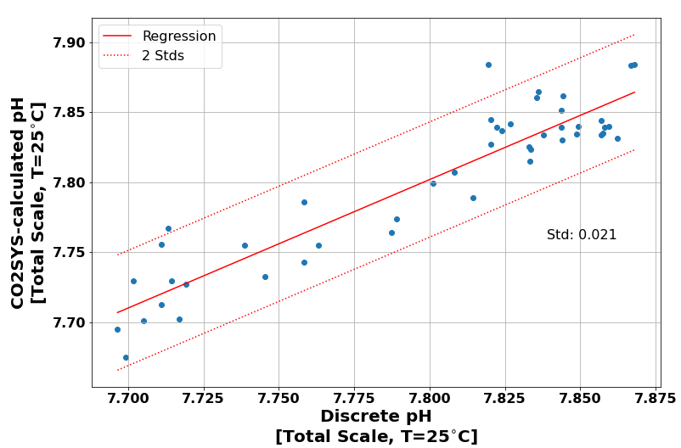
Assessment of CO2SYS Accuracy for Irminger
Comparison of the pH calculated from the DIC and TA using the CO2SYS program against the bottle pH [Total Scale at 25C]. Results agree to within +/- 0.021 pH-units.

Slide 16
Data Processing
Retrieve desired datasets from either OOI Data portal or OOI Data Explorer
Download associated annotations for a given dataset
Identify data marked as bad and remove
Process the datasets for low-quality measurements and remove
Based on code provided by Sunburst Sensors, LLC
Python code implemented by Chris Wingard (Oregon State University - Endurance Array)
Match Discrete Bottle Data with instrument samples
Algorithm matches bottles with instrument data using thresholds of:
5 km horizontal
15 m vertical
7 days
Average the instrument data associated with a discrete sample

Slide 17
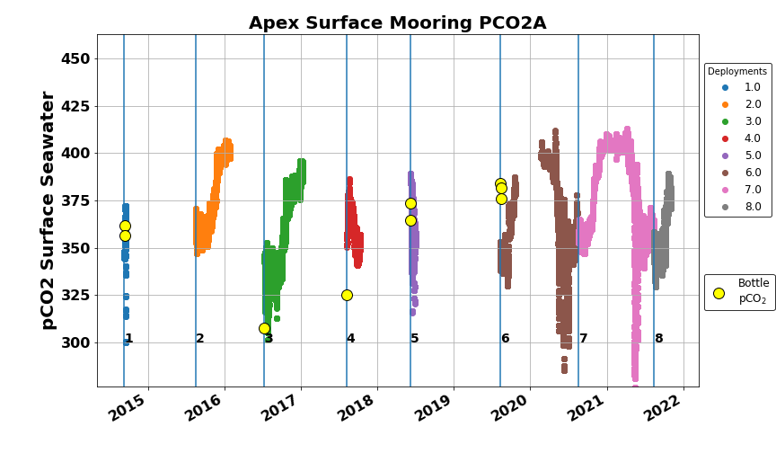
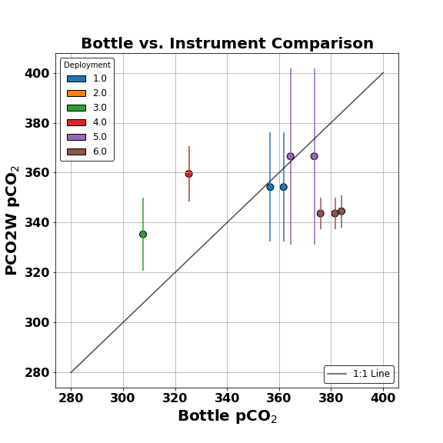
Irminger Surface pCO2
Figure (above): Time series of the Irminger Surface Buoy Pro-Oceanus seawater pCO2, color coded by deployment, with nearest discrete carbon samples overlaid. Frequent data gaps are common due to instrument failure and/or loss of power.
Figure (right): Comparison of the PCO2A measured pCO2 with matched bottle pCO2, with 1:1 line drawn for comparison

Slide 18
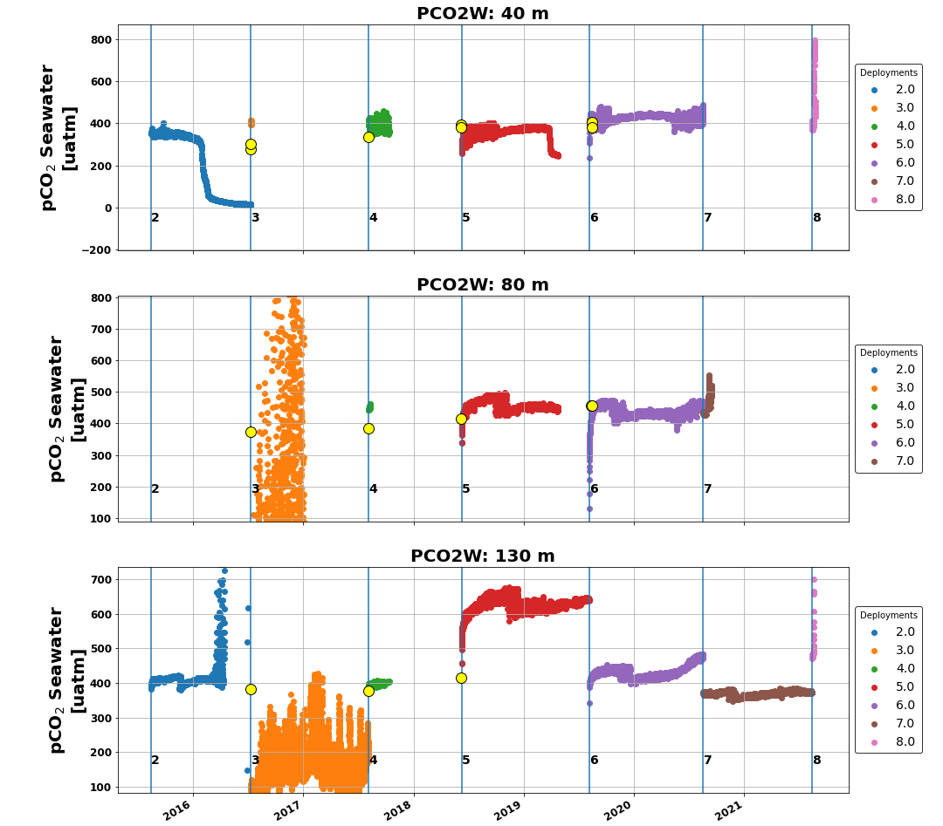
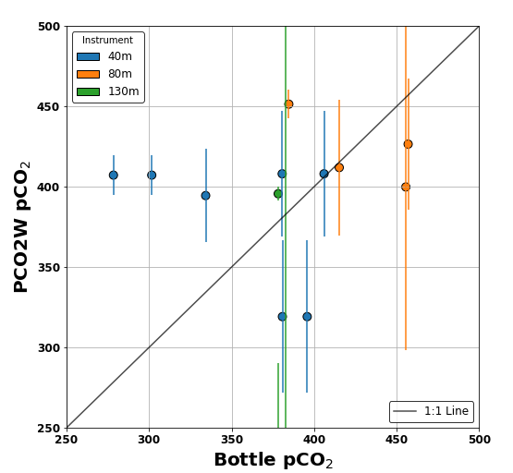
Irminger Water Column pCO2
Left: Time series of the Irminger Apex mooring’s Sunburst SAMI-CO2 seawater pCO2, color coded by deployment, with nearest discrete carbon samples overlaid. Frequent data gaps are common due to instrument failure and/or loss of power.
Above: Comparison of the PCO2W measured pCO2 with matched bottle pCO2, with 1:1 line drawn for comparison. Vertical lines are two standard deviations.

Slide 19
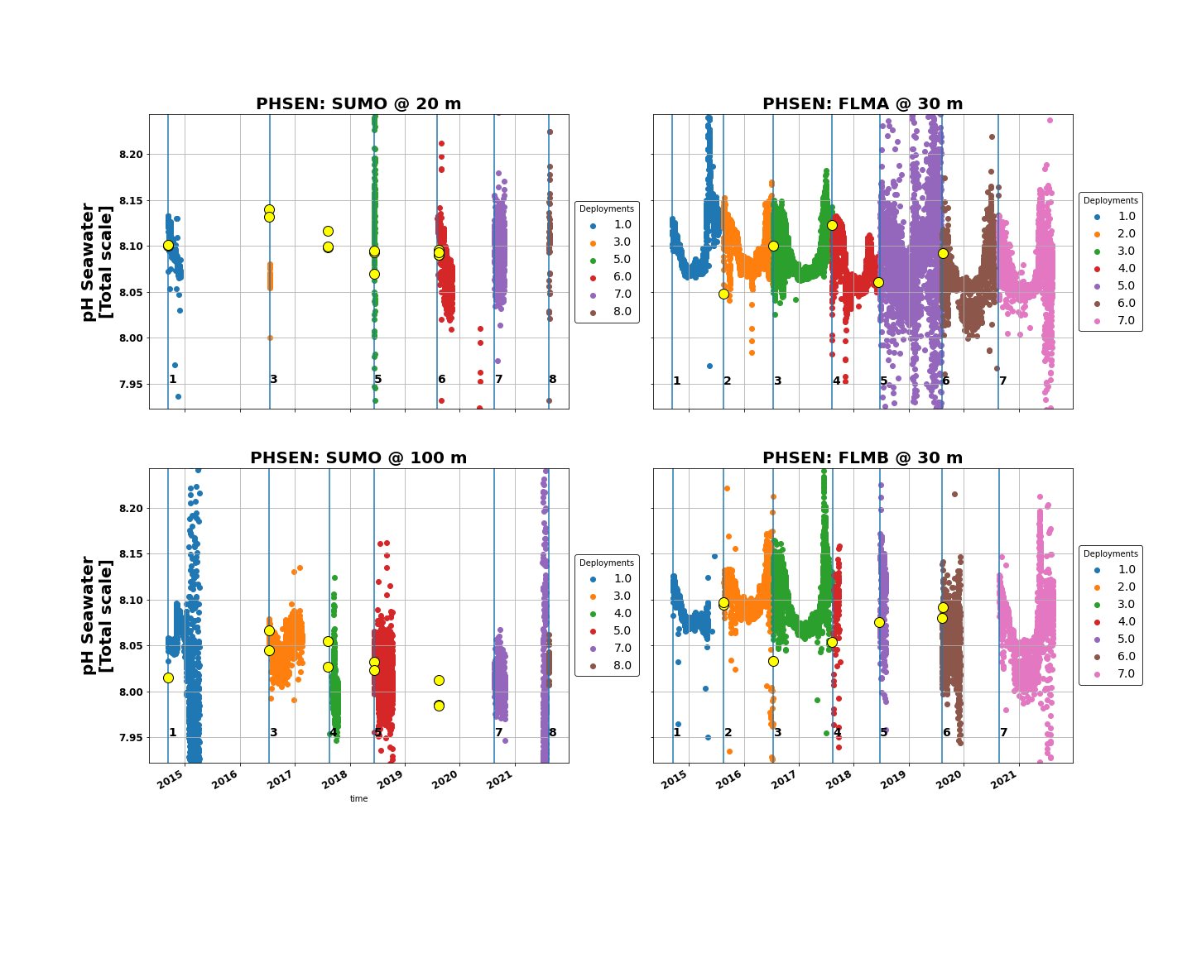
Irminger Water Column pH
Time series of the Irminger Array’s Sunburst SAMI-pH seawater pH, color coded by deployment, with nearest discrete carbon samples overlaid. The instruments on the Flanking Moorings are protected by the buoy and thus have more consistent data returns than the instruments on the Apex Surface Mooring wire.

Slide 20
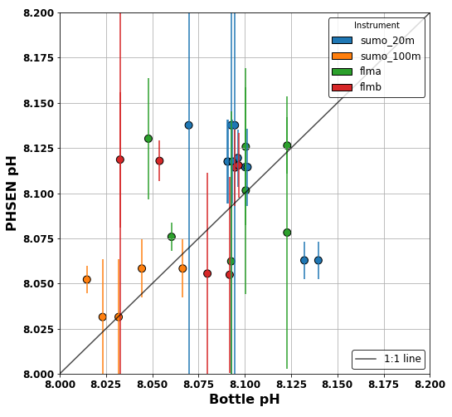
Irminger Water Column pH
Time series of the Irminger Array’s Sunburst SAMI-pH seawater pH, color coded by deployment, with nearest discrete carbon samples overlaid. The instruments on the Flanking Moorings are protected by the buoy and thus have more consistent data returns than the instruments on the Apex Surface Mooring wire.
Comparison of the PHSEN measured pH with matched bottle pH, with 1:1 line drawn for comparison. Vertical lines are two standard deviations.

Slide 21
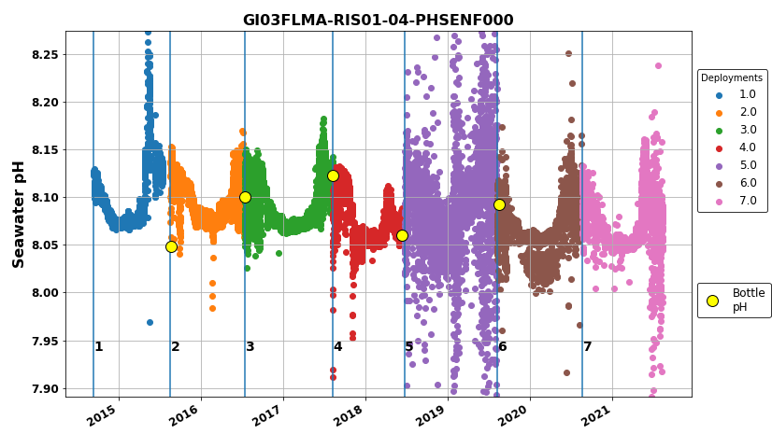
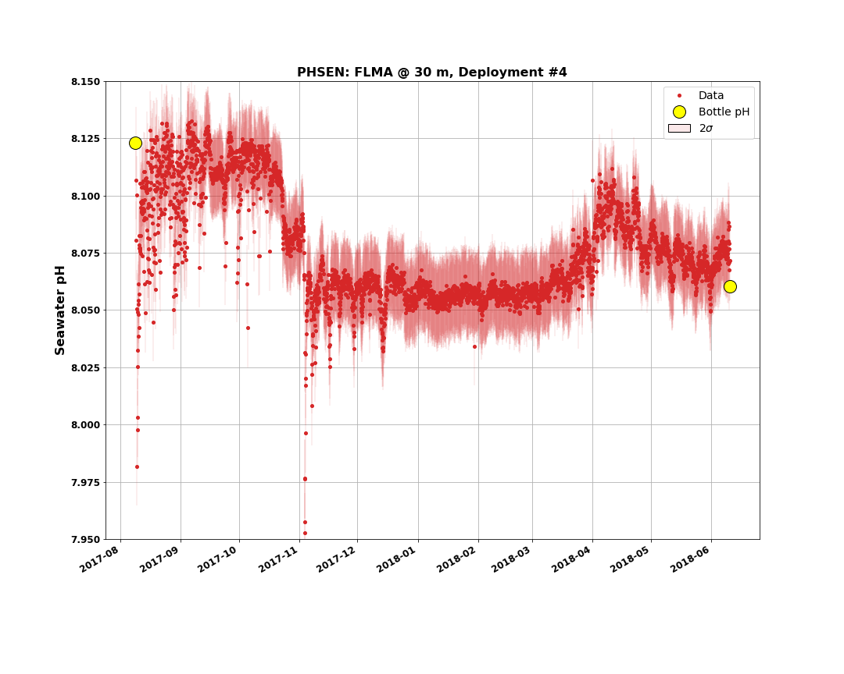
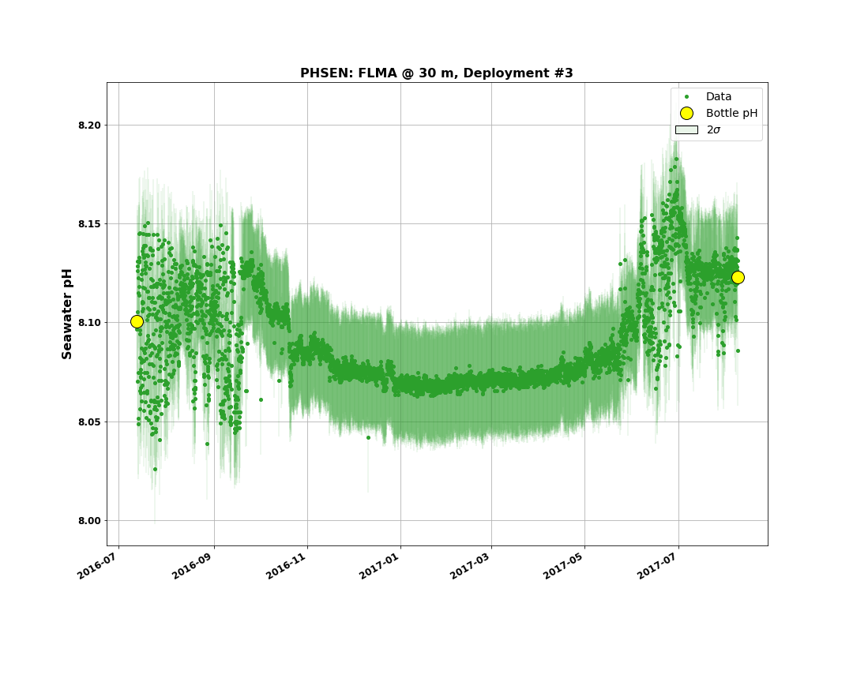
Irminger Water Column pH: Flanking Mooring A

Slide 22
OOI Carbon System Data
OOI is successfully measuring pH and pCO2 at the Irminger Array!
Three instruments which collect time series of pCO2 and pH
Pro-Oceanus: pCO2 at the surface for coastal and global arrays
Sunburst SAMI-pCO2: seawater pCO2 at global arrays throughout the upper ocean
Sunburst SAMI-pH: seawater pH at global arrays throughout the upper ocean
Complex measurement techniques means significant data challenges
Power interruptions, biofouling, harsh conditions - can complicate data collection
SAMIs: complex, long measurement, lots of moving parts, use wet chemistry
Collected along with complementary other parameters
On the arrays: CTD, dissolved oxygen, SUNAs measuring nitrate, ADCPs, Chlorophyll sensors, etc.
Ship data which can be used for in-situ comparison and calibration of sensors

Slide 23
Resources
OOI Data Explorations Notebooks
Provide tools for accessing and downloading data from OOINet API
Also include some post-processing Data QC routines for specific instruments, such as pH
Started by the Coastal Endurance group, actively maintained and added to by all OOI groups
On gitHub at https://github.com/oceanobservatories/ooi-data-explorations
Discrete Water Sampling Data
Measures DIC, TA & pH (Coastal Pioneer & Global Arrays) or DIC & pCO2 (Coastal Endurance & Cabled Array)
Also measures nutrients, chlorophyll, salts, oxygen
Available on the Ocean Observatories Alfresco Document Server: alfresco.oceanobservatories.org
OOI Discourse: https://discourse.oceanobservatories.org/
Jupyter notebooks and supporting code used to prepare the data and figures in this presentation are available at https://github.com/reedan88/Ocean-Sciences-2022

Slide 24
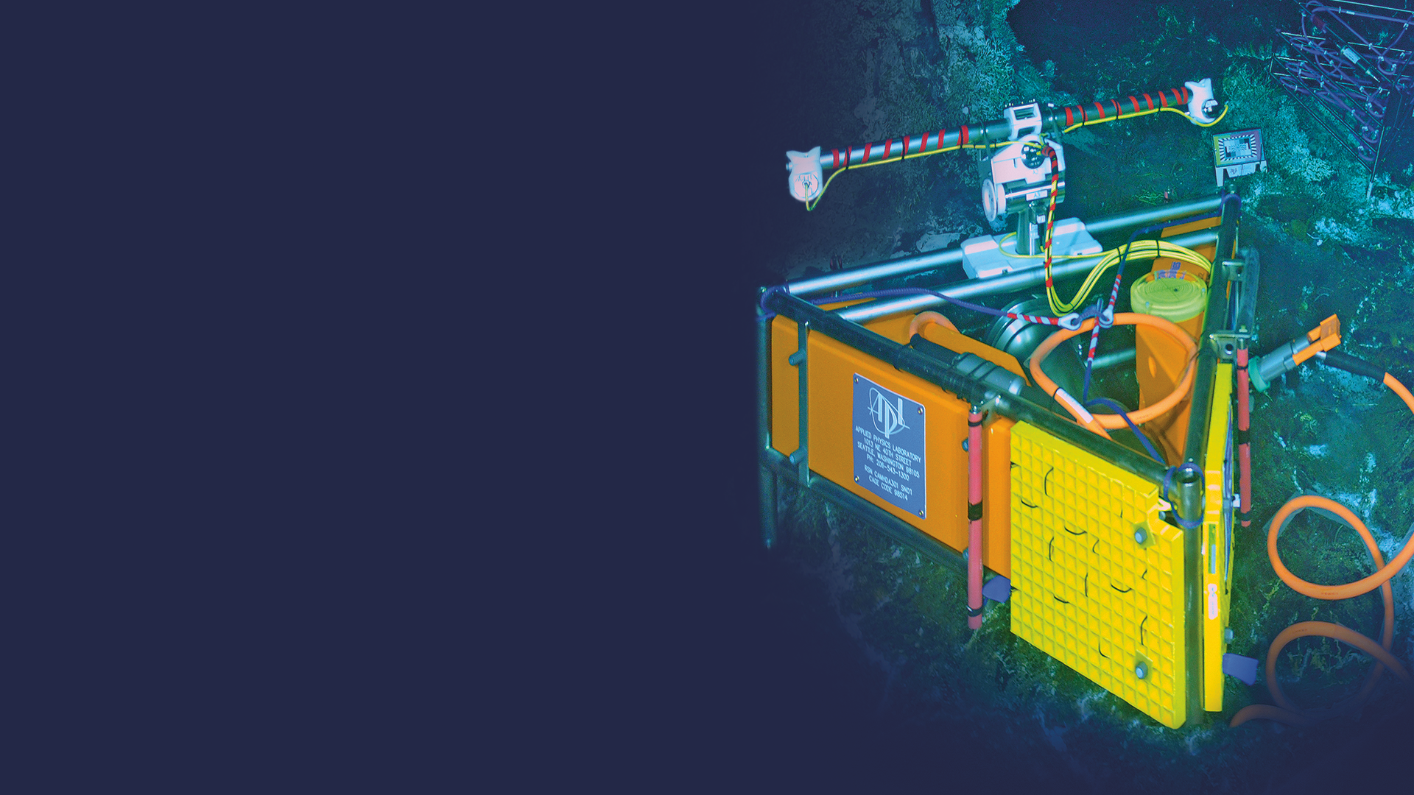

Questions?

